Slide 1

DELL TECHNOLOGIES
PORTAFOLIO DE SERVICIOS
Diego Moure

Slide 2



DELL SERVICES
What’s in it for you?
One-stop-shop for complete solution
Maximize Revenue
Customer Satisfaction

Slide 3
PRODEPLOY SUITE FOR DELL EMC
The right assistance to keep up with evolving technology needs
PLANNING
Site readiness verification, infrastructure evaluation, project management
CONFIGURATION
Certified Dell EMC deployment engineers provide configuration & testing with options for onsite staffing
INTEGRATION
System testing and validation of Dell EMC products within the existing environment with onsite staff options
INSTALLATION
Onsite hardware installation by expert Dell EMC certified engineers with 24x7 deployment service hours available
TRAINING
Project documentation with knowledge transfer, training credits, 30-day post-deployment configuration assistance

Slide 4


PRODEPLOY SUITE
Deploy & Integrate
Get more out of enterprise technology starting day one
Basic Deployment
ProDeploy
ProDeploy Plus
Onsite hardware installation during business hours
Packaging material disposal using onsite trash and recycling
Single point of contact for project management
Implementation planning
24x7 onsite hardware installation
24x7 remote installation and configuration of system software
Project documentation and knowledge transfer
In-region, single point of contact for project management
24x7 installation and onsite system software configuration
30-days of post-deployment configuration assistance
Training credits for Dell EMC Education Services
Experts
Insights
Ease
55K technical service professionals
Access to consistent, single-source expertise
Over 95% Customer Satisfaction
Reduce planning time by up to 92%*
66% faster time to deploy*
Best-in-class processes based on 30+ years of experience
Up to 49% fewer Technical Support calls**
Deployment services in 124 countries
© Copyright 2018 Dell Inc.
© Copyright 2016 Dell Inc.

Slide 5
PROUPPORT SUITE
Which enterprise choice is right for you?
 |  | BASIC | PROSUPPORT | PROSUPPORT PLUS
PREDEPLOYMENT | Single point of contact for project management |  |  | In-region
 | Site readiness review
 | Implementation planning
 | Technology Service Manager (TSM) engagement for ProSupport Plus entitled devices
DEPLOYMENT | Deployment service hours | Business hours | 24x7 | 24x7
 | Onsite hardware installation*
 | Packaging materials disposal
 | Install and configure system software |  | Remote | Onsite
 | Project documentation with knowledge transfer
POSTDEPLOYMENT | Deployment verification
 | Configuration data transfer to Dell EMC technical support
 | 30-days of post-deployment configuration assistance
 | Training credits for Dell EMC Education Services

Slide 6
SERVICES INTRODUCTION
Enterprise Support Services
Feature Comparison
THE RIGHT SUPPORT FOR YOU
 | BASIC | PROSUPPORT | PROSUPPORT PLUS
Remote technical support | 9x5 | 24x7 | 24x7
Covered products | Hardware | Hardware Software | Hardware Software
Onsite hardware support | Next business day | Next business day or 4hr mission critical | Next business day or 4hr mission critical
3er party collaborative assistance
Access to software updates
Self-Service case initiation and management
Automated issue detection & proactive case creation
Priority access to specialized support experts
3er party software support
Assigned Technology Service Manager
Personalized Assessments and recommendations
Semiannual systems maintenance

Slide 7
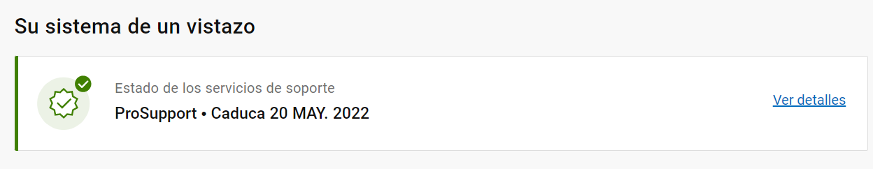
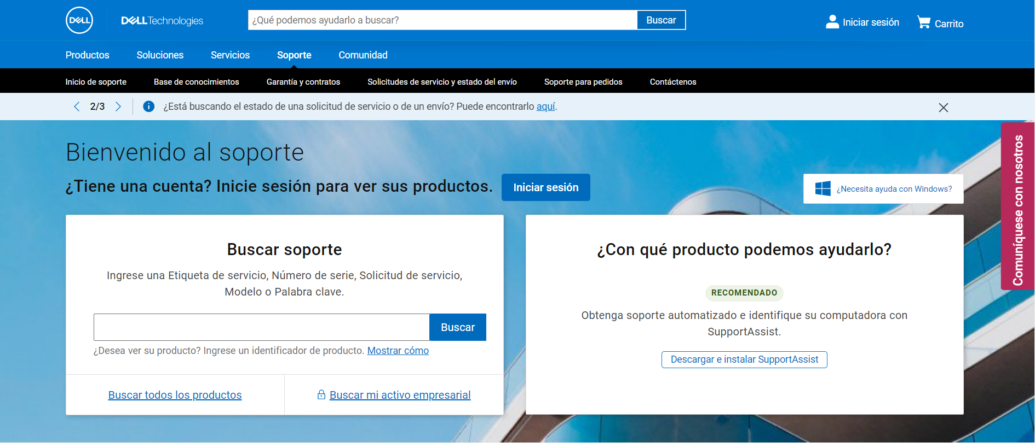
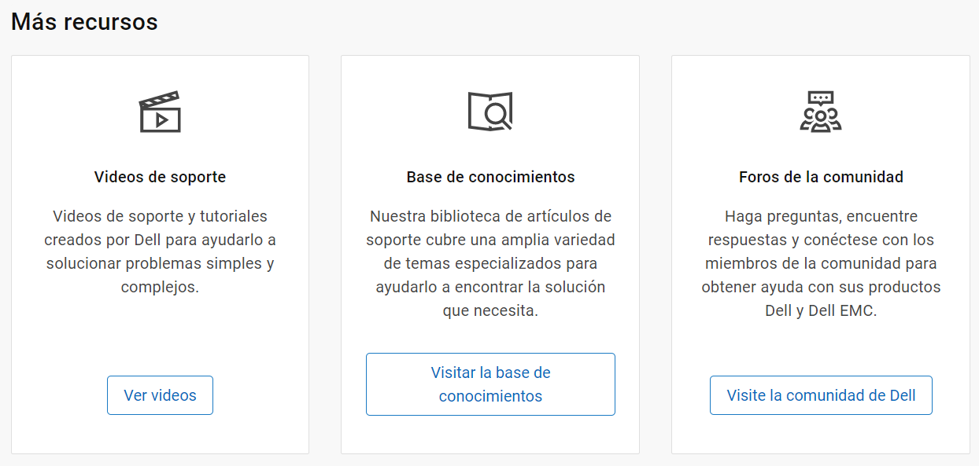
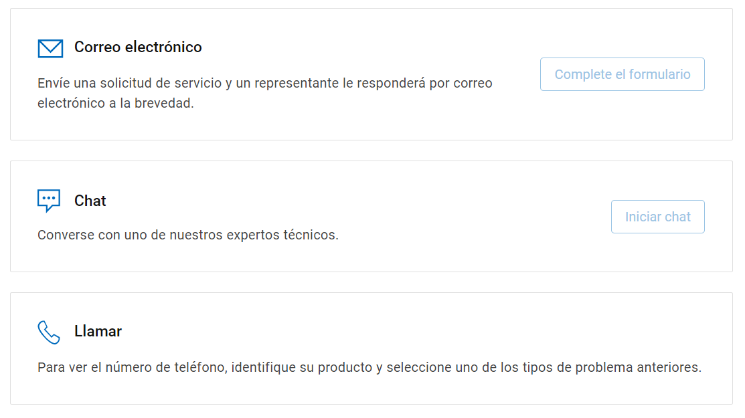

Dell Support
www.dell.com/soporte

Slide 8
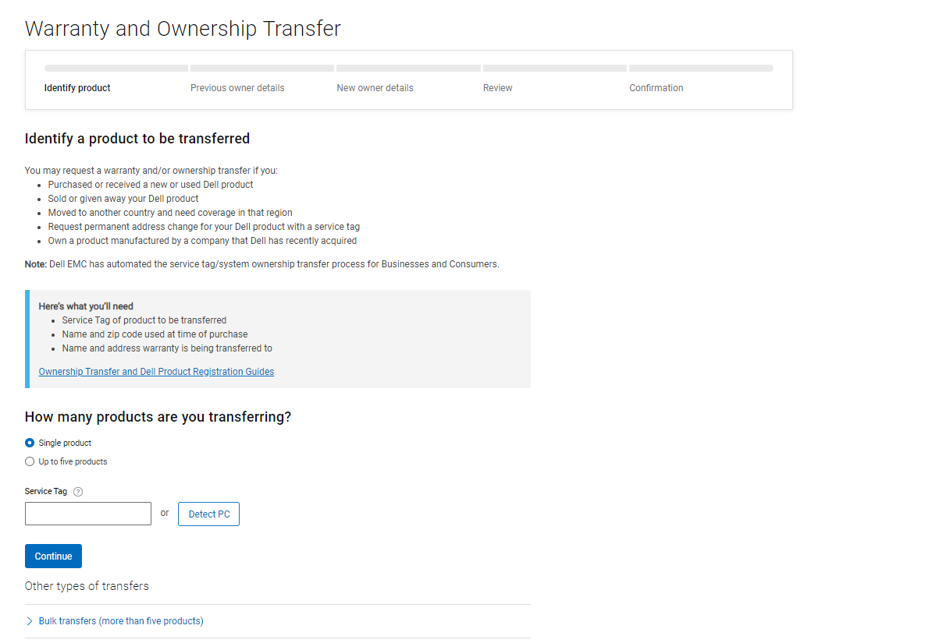
Ownership Transfer
www.dell.com/support/assets-transfer

Slide 9
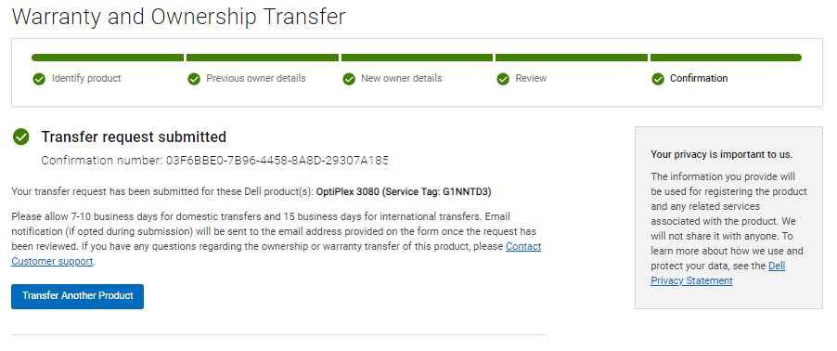
Confirmation Number

Slide 10

QUESTIONS

